Slide 1
Extractive Text summarization
Harsh Vora – A20445400
Dimple Mehra – A20457225

Slide 2
Problem Statement
The size of information on the internet is increasing. It has become tough for the users to dig into the loads of information to analyze it and draw conclusions. Text summarization solves this problem by generating a summary, selecting sentences which are most important from the document without losing the information.
Extractive Text Summarization is an approach for generating short and precise summaries for long text documents.
It uses a Restricted Boltzmann Machine to select important sentences from the text still keeping the summary meaningful and lossless.

Slide 3
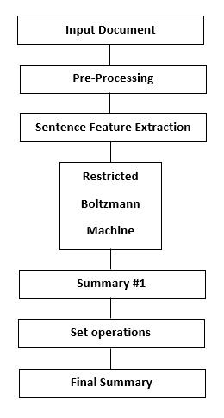
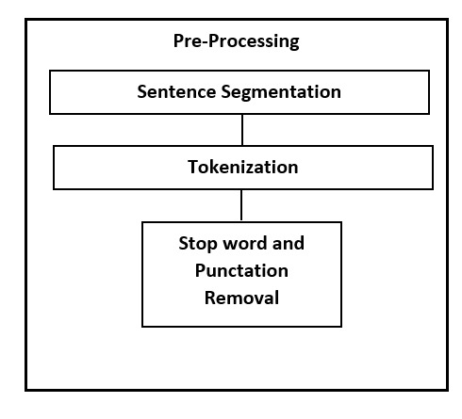
Proposed Solution
Used two layers of Restricted Boltzmann Machine as a Deep Belief Network to reinforce and abstract various features like named entities, proper nouns, numeric tokens, sentence position etc. to attain sentences then selecting the highest scores, hence producing an extractive summary.
The proposed method for text summarization using Deep Learning.

Slide 4
Implementation details
Data Pre-processing:
Ambiguities is caused by various verb sorts of one word, different accepted spellings of a specific word, plural and singular terms of the identical things. Moreover, words sort of a, an, the, is, of etc. are referred to as stop words. These are certain high frequency words that don't carry any information and don’t serve any purpose towards our goal of summarization.
All the pre-processing steps are carried out using a library in python called as Natural Language Toolkit (NLTK).
During this phase we do:
Document Segmentation
Paragraph Segmentation
Word Normalization
Stop Word Filtering
PoS Tagging

Slide 5
Feature Extraction:
Once the complexity has been reduced and ambiguities are removed, the document is structured into a sentence-feature matrix.
A feature vector is extracted for every sentence. These feature vectors frame the matrix.
The mix of the subsequent 9 sentence features has clad best suited to summarize factual reports.
These computations are done on the text obtained after the pre-processing phase: Number of thematic words, Sentence position, Sentence length, Sentence position relative to paragraph etc.
Feature Enhancement:
The sentence-feature matrix has been generated with each sentence having 9 feature vector values.
After this, recalculation is completed on this matrix to reinforce and abstract the feature vectors, so on build complex features out of easy ones. This step improves the standard of the summary.

Slide 6
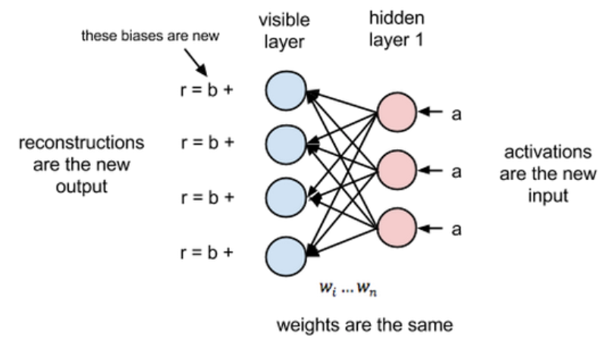
The RBM that we are using has 9 perceptrons in each layer with a learning rate of 0.1.
We've trained RBM for fourteen epochs with a batch size of 5 and 5 parallel Gibbs Chains, used for sampling using Persistent CD method.
Summary Generation:
The enhanced feature vector values are summed to come up with a score against each sentence. The sentences are then sorted in line with decreasing score value.
The foremost relevant sentence is that the first sentence during this sorted list and is chosen as a part of the subset of sentences which can form the summary.
This process is recursively and incrementally repeated to pick out more sentences until a user specified summary limit is reached.
The sentences are then re-arranged within the order of appearance within the original text. This produces a coherent summary instead of a group of haywire sentences.

Slide 7
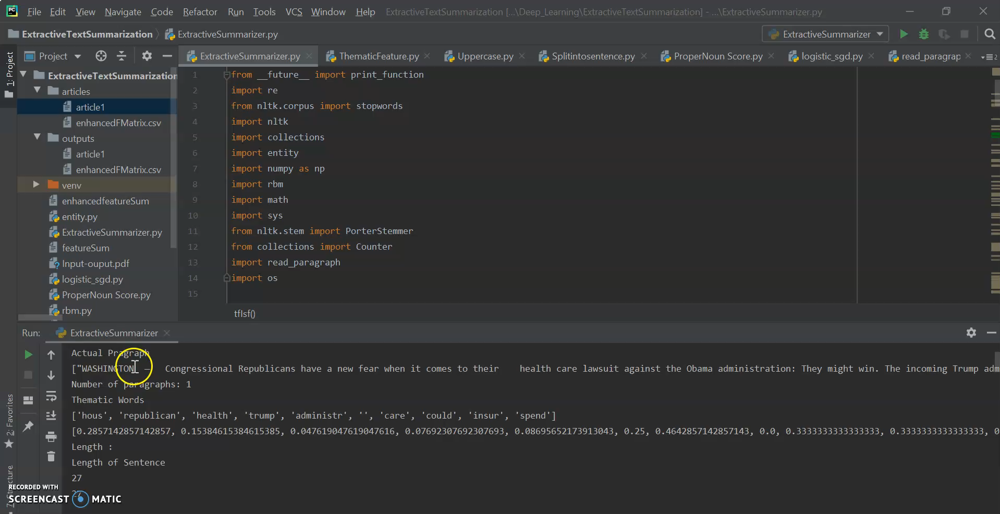
Walkthrough code

Slide 8
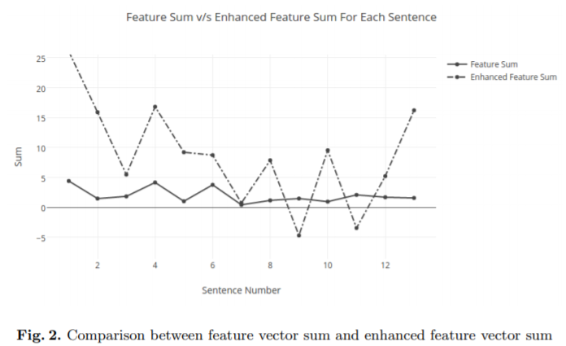
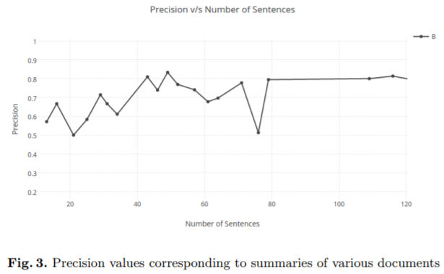
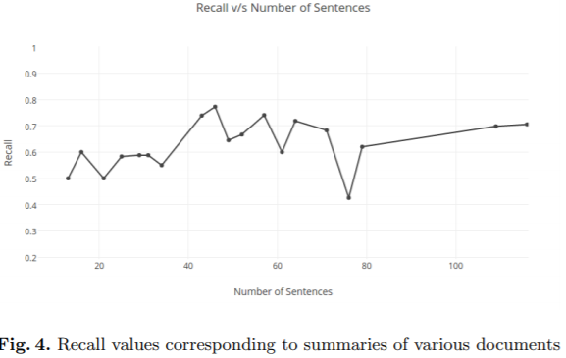
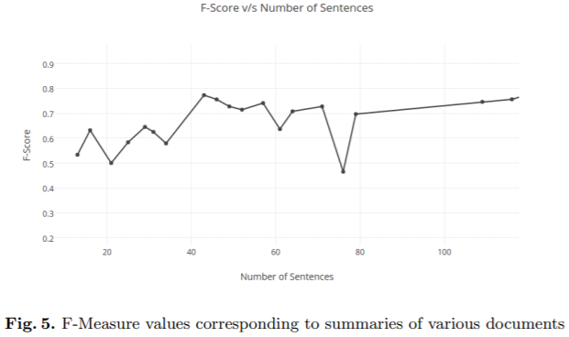
Results and Discussion

Slide 9
Conclusion
We have developed an algorithm to summarize single-document factual reports. The algorithm runs separately for every input document, rather than learning rules from a corpus, as each document is exclusive in itself. This can be a bonus that our approach provides.
We extract 9 features from the given document and enhance them to attain each sentence. Recent approaches are using 2 RBMs stacked on top of every other for feature enhancement.
Our approach uses just one RBM and, works effectively and efficiently for factual reports. This has been demonstrated by hand-picking factual descriptions from several domains. This approach can further be developed by adapting the extracted features as per the user’s requirements and further adjusting the hyperparameters of the RBM to attenuate processing and error in encoded values.

Slide 10
References
Sources:
Nikhil S. Shirwandkar, Samidha Kulkarni - Extractive Text Summarization Using Deep Learning In: IEEE (2018 Fourth International Conference on Computing Communication Control and Automation (ICCUBEA))
Zhang, Y., Wang, D., Li, T.: iDVS - An Interactive Multi-Document Visual Summarization System: Machine Learning and Knowledge Discovery in Databases, LNCS,vol. 6913, pp. 569-584. Springer, Heidelberg (2006). doi: 10.1007/978-3-642-23808-6 37
Wan, X., Xiao, J.: Single Document Keyphrase Extraction using Neighborhood Knowledge. In: Proceedings of the Twenty-Third AAAI Conference on Artificial Intelligence (2008).
H. P. Luhn, “The automatic creation of literature abstracts,” IBM Journal of Research Development, vol. 2, no. 2, pp. 159-165, 1958.
RBM, rbm.py [Online] Available: http://deeplearning.net/tutorial/code/rbm.py [Accessed: April 22, 2020]
Logistic_sgd, logistic_sgd.py [Online] Available: http://deeplearning.net/tutorial/code/logistic_sgd.py [Accessed: April 22, 2020]

